Slide 1

Reading Data From Excel to Table using MATLAB App Designer
Nahiyan Bin Noor
University of Arkansas at Little Rock

Slide 2
Creating a Table
Take table and push button from Components.
Number of columns can be adjusted.
Read the data from ‘random.xlsx’. It should be kept in the current MATLAB Directory.
When the push button will be pushed it will read the data from excel file.
Add the callback according to this.

Slide 3
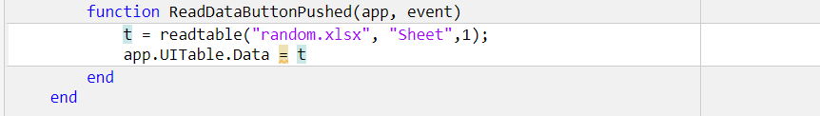
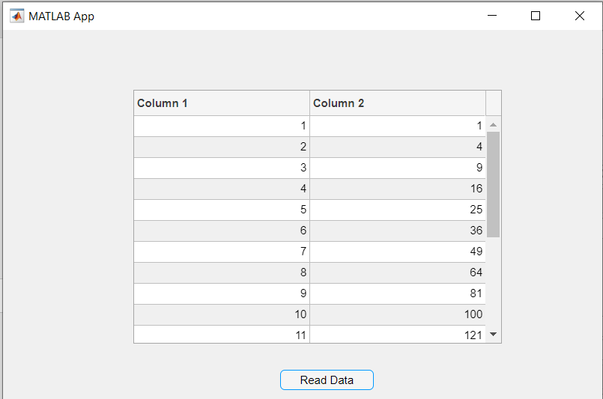
Callback for the Push Button

Slide 4
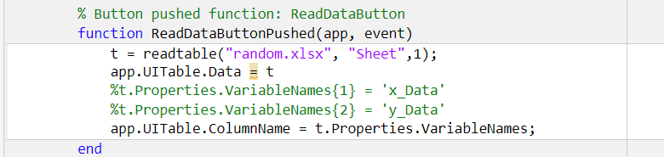
Callback for the Push Button

Slide 5
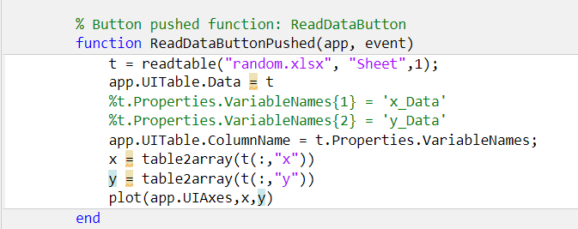
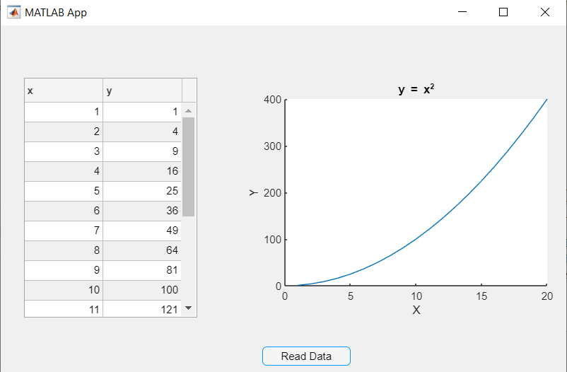
Plot Data from the Table

Slide 6
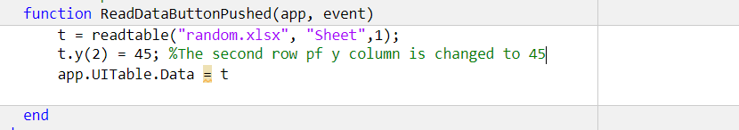
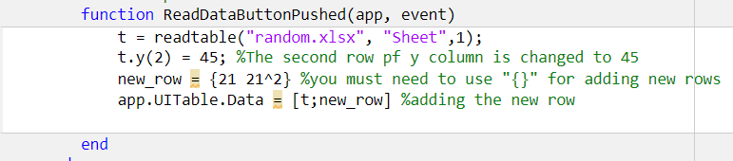
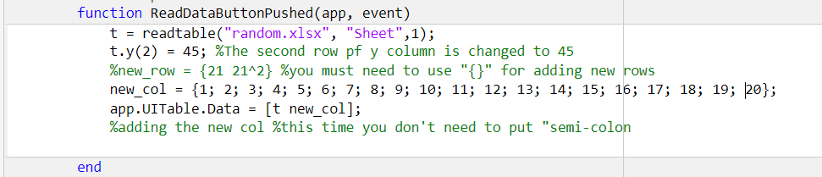
Manipulating Data
Changing value:
You can see the changes in Table in your app.
Adding a new row:
Adding a new row:

Slide 7
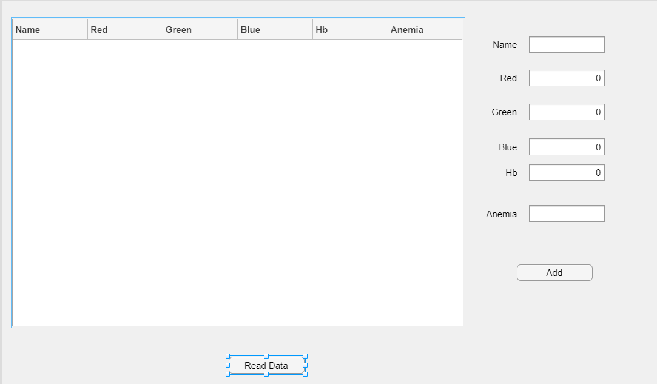

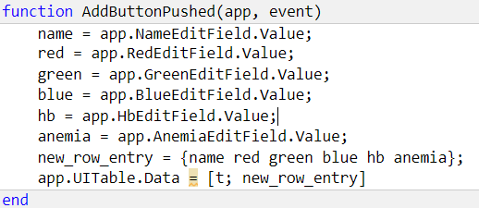
Let’s work with some real dataset
Create an interface:
Add this code to “Read Data” Callback
Add this code to “Add” Callback (New callback)

Slide 8

ERROR
Unrecognized function or variable 't'

Slide 9
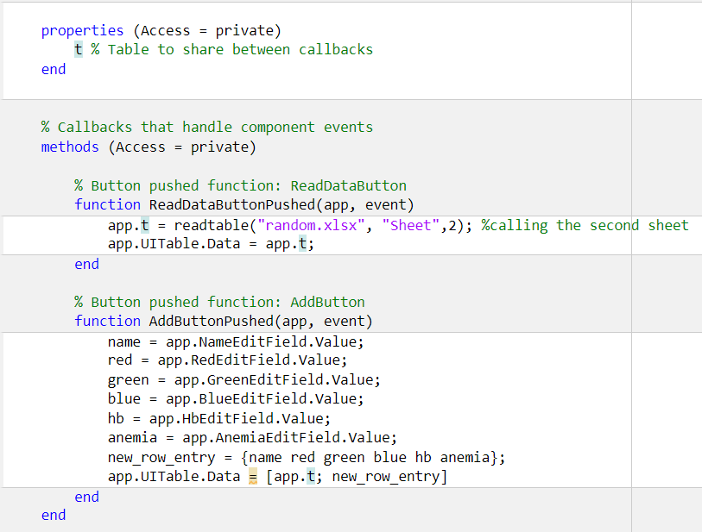
Let’s work with some real dataset
Create a Property:
Add a property to create a variable to store and share data between callbacks and functions. Specify property name with the prefix “app” to access the property value.
app.property = someData
Replace all “t”s with “app.t” in your code.

Slide 10

There is another Problem
Each time you add new entry, the previous one is replaced with the new one.
This is because we haven’t updated the new entry.
Just add an extra line of code to fix it up.
Update the table after each entry.

Slide 11
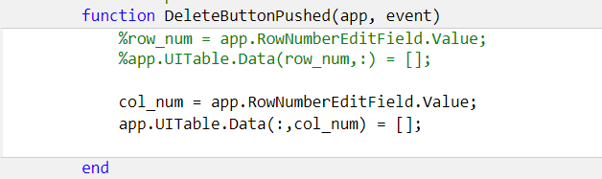
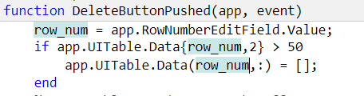
Deleting Rows & Columns from Table
Deleting Rows & Columns:
Parenthesis is needed here as we want to access all rows or all columns.
If we want to access individual rows or column we need to use “{ }” .
Adding a conditional Statement while Deleting Rows & Columns:

Slide 12
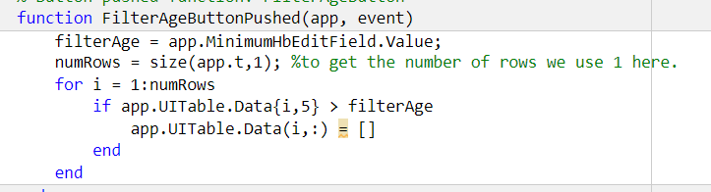
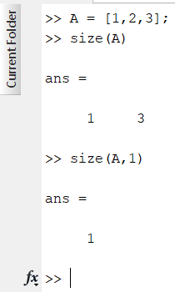
Deleting Rows & Columns from Table
Filtering:

Slide 13
ERROR
Row index exceeds table dimensions.

Slide 14
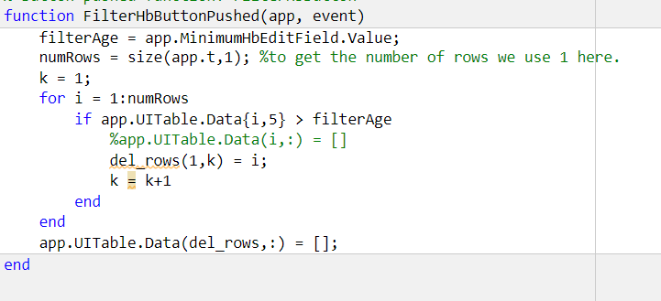
Deleting Rows & Columns from Table
Filtering Rows & Columns:

Slide 15
Task
Work with Sheet 2
Analyze each rows carefully and see which rows might be an outlier. You can use graph/plot to analyze this.
Remove those Outliers from the Table.
Delete the column containing Anemic Condition mentioned. (6th Column)
Now detect the patients who have Anemia based on the Hb value.
Usually, Hb value less or equal to 10 is known to be anemic.

Slide 16

THANK YOU
Happy Vacation

